Slide 1
The Relational Model
Lecture # 3A
Imran Siddiqi
imran.siddiqi@mcs.edu.pk
Computer Science Department
College of Telecommunication Engineering
National University of Sciences and Technology

Slide 2
Contents
Relations – Basic Concepts
The Relational Model
Introduction to SQL
Integrity Constraints
Mapping ERD to Tables

Slide 3
Data Models
Recap
A collection of tools for describing:
  Data
  Data relationships
  Data semantics
  Data constraints
Entity-Relationship model
Relational model

Slide 4

ER Model
Recap
A high level data model based on perception of a real world comprising a collection of entities and of relationships among these entities
Relational Model
A lower level data model that uses a collection of tables to represent both data and relationships among those data

Slide 5
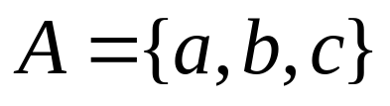
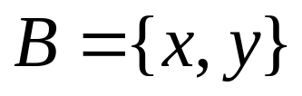
Relation in Mathematics
Recall: Mathematics
Relation: A subset of the Cartesian product

Slide 6
Relation: Example
customer-name = {Jones, Smith, Curry, Lindsay}
customer-street = {Main, North, Park}
customer-city = {Harrison, Rye, Pittsfield}
r = { (Jones, Main, Harrison),
(Smith, North, Rye),
(Curry, North, Rye),
(Lindsay, Park, Pittsfield)}
is a relation over
customer-name x customer-street x customer-city

Slide 7

Basic Concepts
3 Attributes each having a set of permitted values - Domain
Table: Account
Let:
D1 = set of all account numbers
D2 = set of all branch names
D3 = set of all balances
Each row must consist of a 3-tuple (v₁,v₂,v₃)
v₁ is an account number (v₁ is in domain D1)
v₂ is a branch name (v₂ is in domain D2)
v₃ is a balance (v₃ is in domain D3)

Slide 8


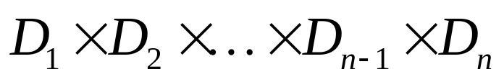
Basic Concepts
D1 = set of all account numbers
D2 = set of all branch names
D3 = set of all balances
Account will be a subset of
A table with n attributes will be a subset of

Slide 9
Relation: Definition
Given sets D₁, D₂, …. D_{n} a relation r is a subset of
D₁ x D₂ x … x D_{n}
Thus a relation is a set of n-tuples (a₁, a₂, …, a_{n}) where
each a_{i} ∈ D_{i}
Relation is composed of tuples
Tuple = sequence of attribute values
Relation schema:
  relation name + attribute names + attribute types
Database schema: set of relation schemas
Use: Relation for Table & Tuples for Rows

Slide 10
Relational Schema
A relation schema describes the name of the table/relation and the name (and domain) of each field (or column, or attribute)
Examples
A1, A2, …, An are attributes
R = (A1, A2, …, An ) is a relation schema
Customer = (customer-name, customer-street, customer-city)
Another way:
Students(sid : string, name : string, age : integer, gpa : real)

Slide 11
Relation Instance
The current values (relation instance) of a relation are specified by a table
An element t of r is a tuple, represented by a row in a table
The order is not relevant
attributes
(or columns)
customer-name
customer-street
customer-city
Jones
Smith
Curry
Lindsay
Main
North
North
Park
Harrison
Rye
Rye
Pittsfield
tuples
(or rows)
customer

Slide 12
Schema versus Instance
DB instances change continuously
  E.g. Customers are added, deleted etc.
The schema is stable
  Attributes change very rarely
A RDB instance is the set of tuples that are ‘now’ in the DB
When designing the DB only the schema is important i.e. the structure of the DB
We only imagine typical instances to help us with the design

Slide 13
Relations: Terminology
The degree or arity of a relation is its number of fields
The cardinality of a relation is the number of tuples in it.
A relational database is a collection of relations with distinct relation names
An instance of a relational database is a collection of relation instances, one per relation schema in the database schema

Slide 14
SQL
In SQL a table denotes a relation
We use the Data Definition Language –DDL– to create, modify or delete tables
The command CREATE TABLE is used to define a table
CREATE TABLE students (
sid char (20),
name char (30),
login char(20),
age integer,
gpa real
);

Slide 15
SQL
To add a tuple to the relation:
INSERT
INTO Students (sid, name, login, age, gpa)
VALUES (53688, ’Smith’, ’smith@ee’, 18, 3.2);
To delete a tuple from the relation:
DELETE
FROM Students
WHERE Name = ’Smith’;

Slide 16
Integrity Constraints over Relations
An integrity constraint (IC) is a condition on the db schema that restricts the data that can be stored in an instance of the db
An instance that satisfies all its ICs is said to be a legal instance
ICs are specified at definition time
ICs are enforced at run time

Slide 17
Key Constraints
A key constraint is a statement that certain minimal subset of the fields of a relation is a unique identifier of the tuple
A set of fields that uniquely identifies a tuple is called a candidate key or just a key:
  Two distinct tuples of the relation cannot have the same values in all the fields of the key
  No subset of the set of fields in a key is a unique identifier of the key
Out of all available keys, the DB designer should identify a primary key

Slide 18
Key Constraints in SQL
At most one of the candidate keys can be declared as a primary key using PRIMARY KEY
create table students (
sid char (20),
name char (30),
login char(20),
age integer,
gpa real,
CONSTRAINT StudentsKey PRIMARY KEY (sid)
);

Slide 19
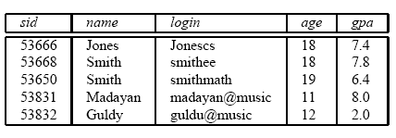
Key Constraints in SQL
If an update or insert causes a violation – it is rejected
Examples – Violation of Primary Key constraint
  Cannot insert a tuple with sid 53688
  Cannot insert a null value in the sid field
Update may cause similar violations

Slide 20
The NULL Value
A special value that means:
  It is not known, or
  It is not applicable
A NULL is not allowed in a primary key

Slide 21
Foreign Key Constraints
Sometimes the information stored in a relation is linked to the information stored in another one
If one is modified, the other must be checked and potentially modified in order to keep the data consistent
Example:
  Enrolled(studid: string, cid: string, grade: string)
We need to ensure that only students in the Students relationship can be added to the Enrolled one
The studid field of Enrolled is called a foreign key and refers to Students.

Slide 22
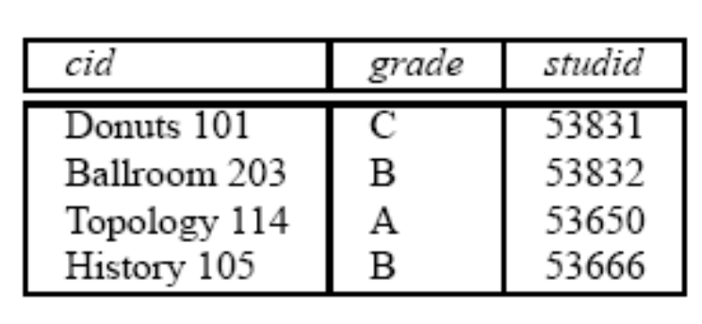
Foreign Key
A foreign key is a column or columns whose values are the same as the primary key of another table
Enrolled
Students
Foreign Key
If we try to insert (55555,Art104,A) into Enrolled, the Foreign Key constraint is violated (it should be rejected by the DBMS)
But, what should it do if we want to delete (53666, Jones, Jonescs, 18, 7.4)

Slide 23
Foreign Key Constraint in SQL
CREATE TABLE Enrolled (
studid char(20),
cid char(20),
grade char(10),
PRIMARY KEY (studid, cid),
FOREIGN KEY (studid) REFERENCES Students
);

Slide 24
Enforcing Integrity Constraints
Consider the Students and Enrolled relations
Question 1
What should we do if an Enrolled row is inserted with a studid column value that does not appear in any row of the Students table?
Answer
Simply reject the insert command

Slide 25

Enforcing Integrity Constraints
Consider the Students and Enrolled relations
Question 2
What should we do if a Students row is deleted?
Answer
Delete the respective rows from Enrolled
Disallow the deletion if an Enrolled row refers to it
Set the studid in Enrolled to some default value
Set the studid in Enrolled to Null

Slide 26
Enforcing Integrity Constraints
Consider the Students and Enrolled relations
Question 3
What should we do if an Students row is updated?
Answer
Similar to the pervious case

Slide 27
Dealing with Foreign Key ICs
When a tuple from Students is deleted or updated what can we do with the Foreign Key in Enrolled
NO ACTION: Delete or updates should be rejected
CASCADE: Update or Delete the dependent FK
ON DELETE SET DEFAULT: The dependent FKs are set to a default FK
ON DELETE SET NULL: The dependent FKs are set to NULL
CREATE TABLE Enrolled (
studid char(20),
cid char(20),
grade char(10),
PRIMARY KEY (studid, cid),
FOREIGN KEY (studid) REFERENCES Students
ON DELETE CASCADE
ON UPDATE NO ACTION
);

Slide 28
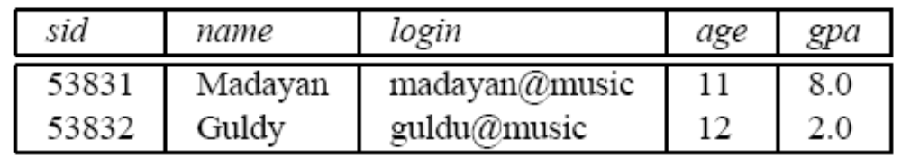
Querying Relational Data
A relational database query is a question we pose on the data
Example:
SELECT * FROM students S WHERE s.age < 18;
Students
Result

Slide 29
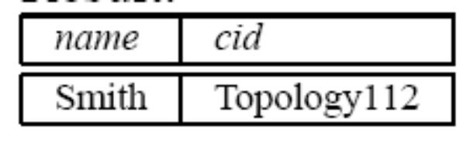
Combining Tables
Find the names of students who got A and the id of the course
SELECT S.Name, E.cid FROM Students S, Enrolled E
WHERE S.sid = E.studid AND E.grade = ’A’;
Students
Result
Enrolled

Slide 30
Mapping ERD to Tables

Slide 31
Entity Sets to Tables
ssn
It is straightforward:
  Each attribute becomes a field
  We also know the primary key of the set
  We need to determine the domain of each field
Students
name
address
Relation: Students
SSN
Name
Address
111-222-3333
Howard
Park Avenue
444-555-6666
John
South Carolina

Slide 32
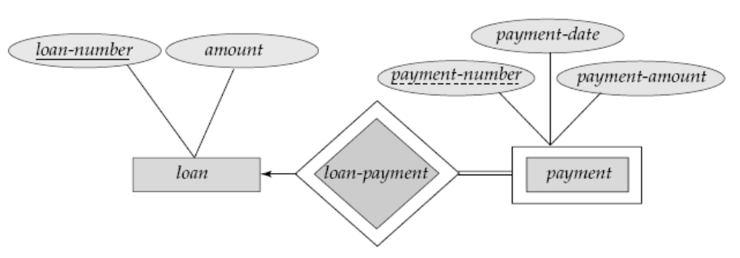
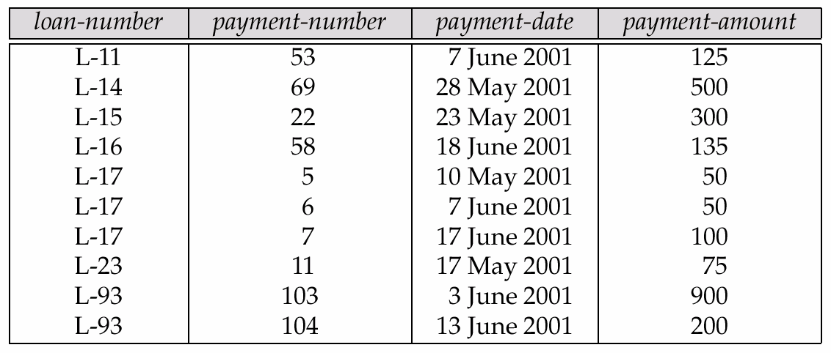
Weak Entity Sets to Tables
A weak entity set becomes a table that includes a column for the primary key of the identifying strong entity set
Relation: Payment

Slide 33
Relationship Sets to Tables
A many-to-many relationship set is represented as a table with columns for the primary keys of the two participating entity sets, and any descriptive attributes of the relationship set
Course-Name
S_addr
Course
Students
Enroll_in
S_Name
CourseID
Relation: Enroll_in
ssn
ssn
CourseID
111-222-3333
C20.0046
111-222-3333
C20.0056
444-555-6666
C30.0046

Slide 34
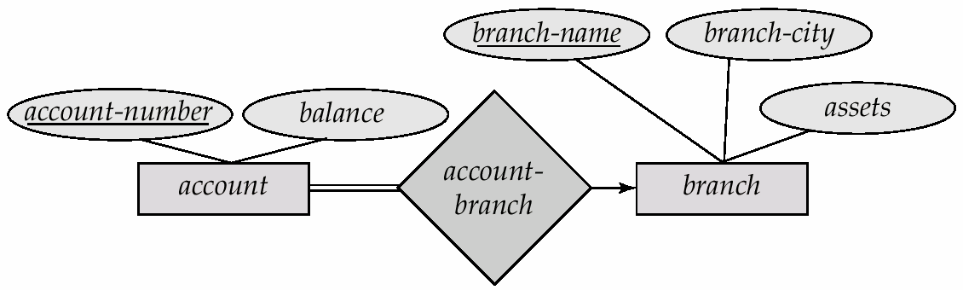
Relationship Sets to Tables
Think about it !!!
Many-to-one and one-to-many relationship sets that are total on the many-side can be represented by adding an extra attribute to the many side, containing the primary key of the one side
If participation is partial on the many side, replacing a table by an extra attribute in the relation corresponding to the “many” side could result in null values
E.g.: Instead of creating a table for relationship account-branch, add an attribute branch to the entity set account

Slide 35
Relationship Sets to Tables
For one-to-one relationship sets, either side can be chosen to act as the “many” side
  That is, extra attribute can be added to either of the tables corresponding to the two entity sets

Slide 36
Weak Relationship Sets to Tables
The table corresponding to a relationship set linking a weak entity set to its identifying strong entity set is redundant
loan – Primary Key = {loan_number}
payment – Primary Key = {loan_number,payment}
Table payment - 4 Attributes: {loan_number,payment_number,payment_date,payment_amount}
Table loan-payment - 2 Attributes:
{loan_number,payment_number}
Table loan-payment is Redundant

Slide 37
Composite Attributes to Tables
Composite attributes are flattened out by creating a separate attribute for each component attribute
EmpNo
FirstName
Employee
Name
MidName
ID
LastName
Given an entity set customer with composite attribute name with component attributes first-name and last-name the table corresponding to the entity set has three attributes: name-FirstName, name-MidName and name-LastName

Slide 38
Multi-valued Attributes to Tables
A multivalued attribute M of an entity E is represented by a separate table EM
Table EM has attributes corresponding to the primary key of E and an attribute corresponding to multivalued attribute M
  E.g. Multivalued attribute PhoneNo of employee is represented by a table
  employee-PhoneNo( employee-id, PhoneNo)
  Each value of the multivalued attribute maps to a separate row of the table EM
    E.g., An employee entity with primary key 151 and telephone numbers 9241456 and 9245467 maps to two rows:
Employee-id | PhoneNo
151 | 9241456
151 | 9245467

Slide 39
Representing Generalization
Method I
Form a table for the higher level entity
Form a table for each lower level entity set, include primary key of higher level entity set and local attributes
Table Table Attributes
account account-number, balance
savings-account account-number, interest rate
checking-account account-number, overdraft-amount

Slide 40
Representing Generalization
Do you remember them?
Method II
If generalization is disjoint and complete
Do NOT create a table for the high level entity set
Form a table for each lower level entity set, and include each attribute of higher level entity set
Table Table Attributes
savings-account account-number, balance, interest rate
checking-account account-number, balance, overdraft-amount

Slide 41
Representing Generalization
Question 1
What if the generalization was overlapping and not disjoint?
Answer
Some values like balance would be stored twice unnecessarily

Slide 42
Representing Generalization
Question 2
What if the generalization were not complete
Answer
The accounts which are neither savings nor checking could not be represented in the database

Slide 43
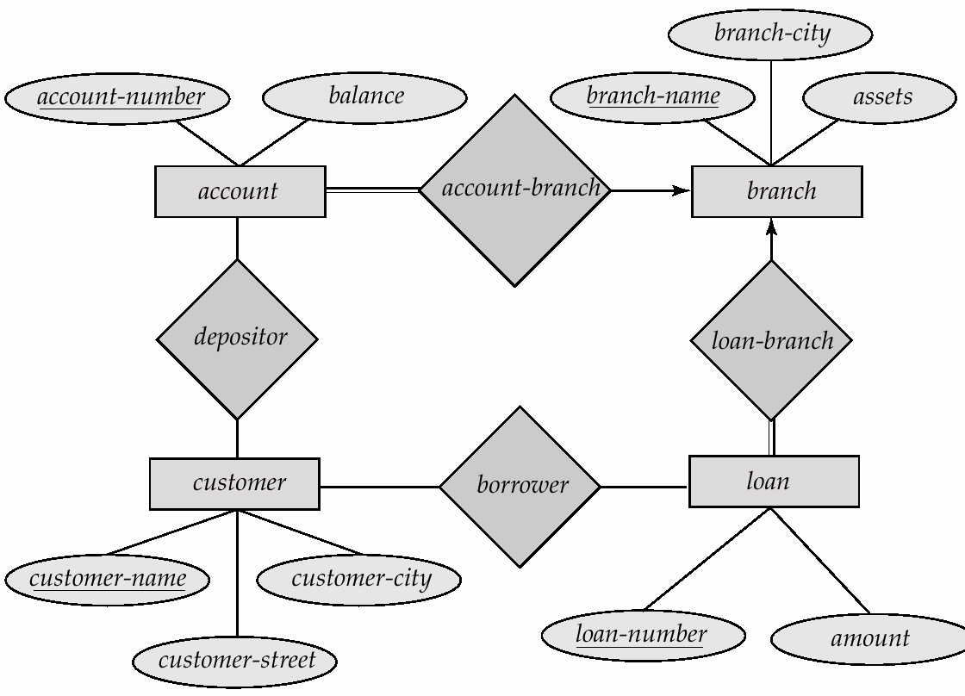
Simplified ERD – Banking Enterprise

Slide 44
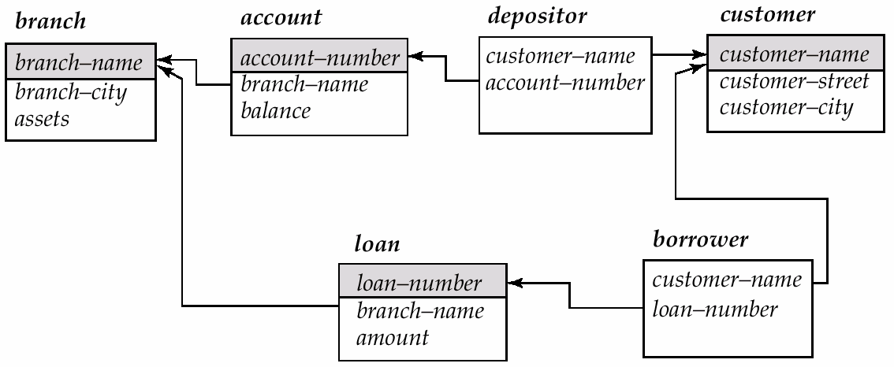
Schema Diagram
Depicts DB schema along with primary key and foreign key dependencies

Slide 45
References
Chapter 3, Database System Concepts, Silberschatz, Korth, Sudarshan

